Slide 1
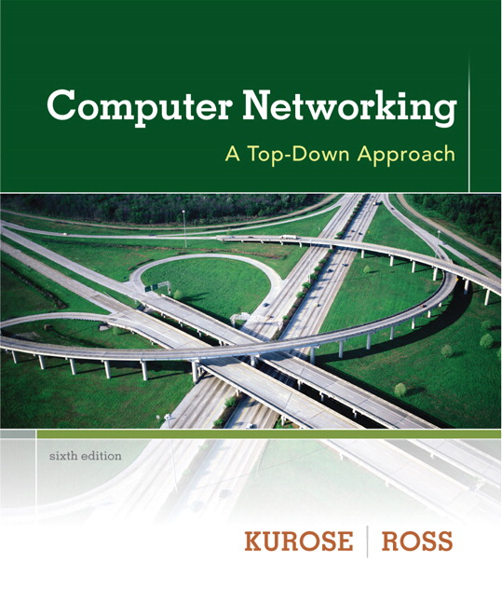

Chapter 5 Network Layer
Computer Networking: A Top Down Approach 6th edition Jim Kurose, Keith Ross Addison-Wesley March 2012

Slide 2
Chapter 5: Network layer
chapter goals:
understand principles behind network layer services:
network layer service models
forwarding versus routing
how a router works
routing (path selection)

Slide 3

















Network layer
Role: transport segment from sending to receiving host
on sending side encapsulates segments into datagrams
on receiving side, delivers segments to transport layer
Network layer protocols in every host, router. The network layer involves each and every host and router in the network.
router examines header fields in all IP datagrams passing through it
application
transport
network
data link
physical
network
data link
physical
network
data link
physical
network
data link
physical
network
data link
physical
network
data link
physical
network
data link
physical
network
data link
physical
network
data link
physical
network
data link
physical
application
transport
network
data link
physical
network
data link
physical
network
data link
physical

Slide 4
Three key network-layer functions
Forwarding/switching: move packets from router’s input to appropriate router output
routing: determine route taken by packets from source to dest. Algorithms that calculate these paths are called routing algorithms
Call setup: With TCP, 3-way handshake is required before data actually flows from sender to receiver. This allows sender & receiver to set up needed state info.
some network architectures require router call setup along path before data flows
analogy:
routing: process of planning trip from source to dest
forwarding: process of getting through single interchange

Slide 5
Interplay between routing and forwarding
routing algorithm
routing algorithm determines
end-end-path through network
local forwarding table
forwarding table determines
local forwarding at this router
header value
output link
0100
0101
0111
1001
3
2
2
1
value in arriving
packet’s header
0111
1
3
2

Slide 6
The Internet network layer
host, router network layer functions:
transport layer: TCP, UDP
routing protocols
path selection
RIP, OSPF, BGP
IP protocol
addressing conventions
datagram format
packet handling conventions
network
layer
forwarding
table
ICMP protocol
error reporting
router “signaling”
link layer
physical layer

Slide 7
The network layer at the sending host receives a segment from the transport layer,
it encapsulates the segment within an IP datagram,
writes the destination host address as well as other fields in the datagram,
Sends the datagram to the first router on the path toward the destination host.
The Internet’s network layer has three major components:

Slide 8
Major components of network layer
The Internet Protocol (IP Protocol – IPv4 & IPv6), which defines network- layer addressing, the fields in the datagram, and the actions taken by routers and end systems on a datagram based on values in these fields.
Second: Path determination component; it determines the route a datagram follows from source to destination. Examples of such components used in the Internet are RIP, OSPF, BGP.
The Internet's network- layer error and information reporting protocol, ICMP, is a facility to report errors in datagrams and respond to requests for certain network- layer information.

Slide 9
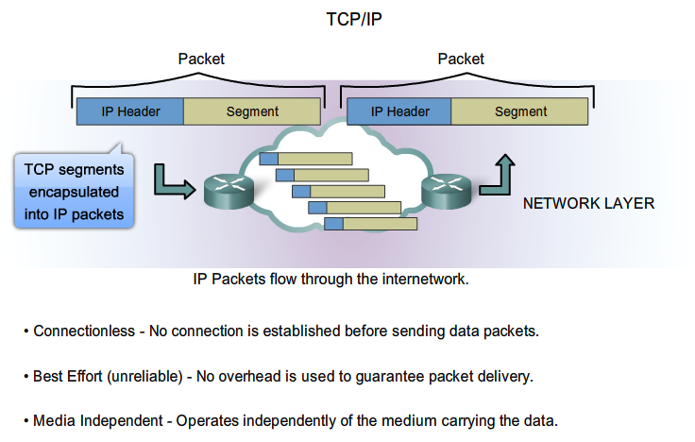
IP Protocol
Notes:
6.1.2.1 Characteristics of IP

Slide 10
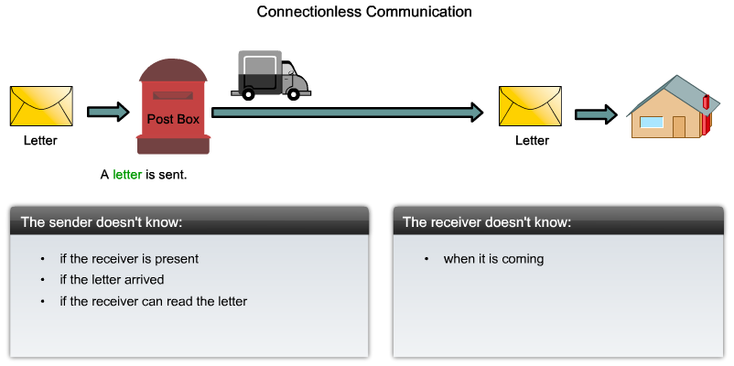
IP Connectionless
Notes:
6.1.2.2 IP – Connectionless

Slide 11
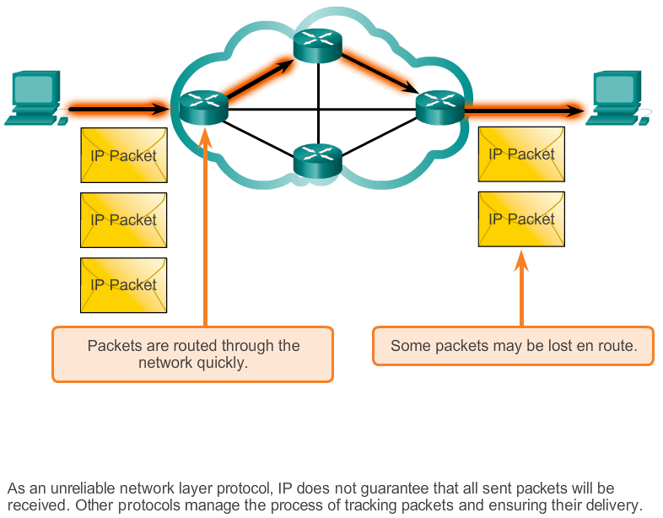
IP - Best Effort Delivery
Notes:
6.1.2.3 IP – Best Effort Delivery

Slide 12
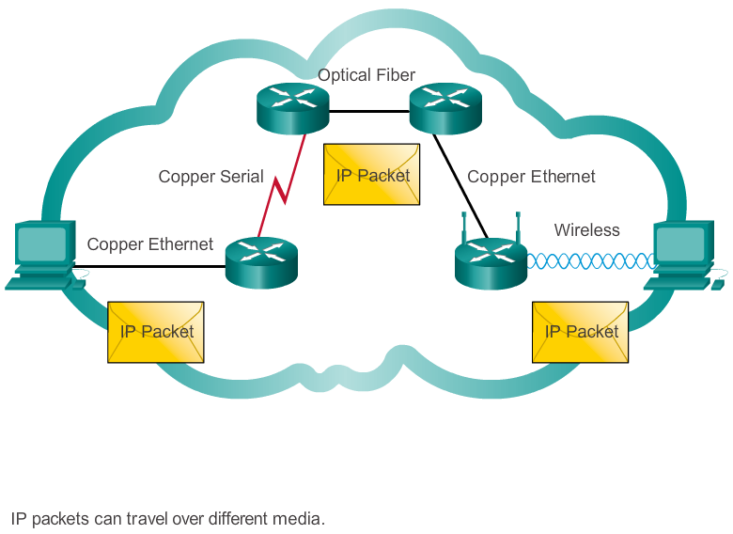
IP - Media Independence
Notes:
6.1.2.4 IP – Media Independent

Slide 13
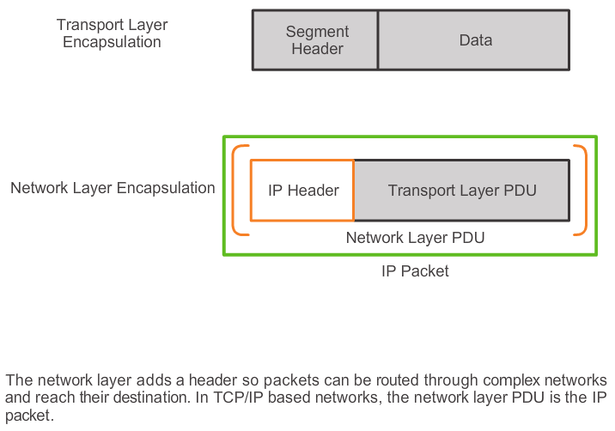
Encapsulating IP
Notes:
6.1.2.5 Encapsulating IP

Slide 14
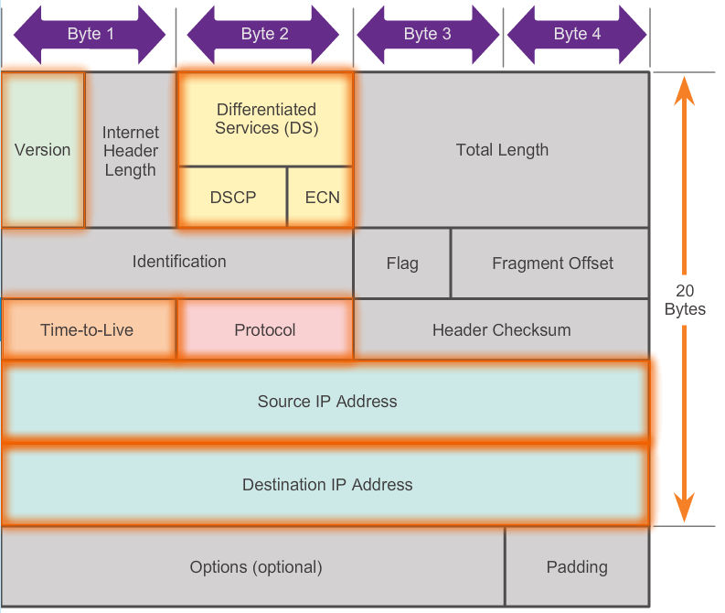
IP datagram format
IP protocol version
number
total datagram
length (bytes)
header length
(bytes)
for
fragmentation/
reassembly
“type” of data
max number
remaining hops
(decremented at
each router)
upper layer protocol
to deliver payload to
how much overhead?
20 bytes of TCP
20 bytes of IP
= 40 bytes + app layer overhead
e.g. timestamp, record route taken, specify list of routers to visit.
Notes:
Version – Version of IP used for data transfer, must be accepted on the other side
Header length – Ranges from 20 – 60 bytes
Total length - Total length of the datagram = Length of the header + Length of the data
The Time to Live (TTL) field is used to specify the time for which a datagram must be retained on the network.
Protocol field is used to specify the protocol used to create the data present in the Datafield e,g TCP, IP, ICMP
Header Checksum field contains the checksum, which is used by the destination to check for the integrity of the transmitted data by applying an algorithm on the IP header. Not the same, discard it

Slide 15
Version – Version of IP used for data transfer, must be accepted on the other side
Header length – Ranges from 20 – 60 bytes
Total length of datagram = Length of header + Data Length
The Time to Live (TTL) field is used to specify the time for which a datagram must be retained on the network.
Protocol field is used to specify the protocol used to create the data present in the Data field e.g., TCP, IP, ICMP
Header Checksum field contains the checksum, which is used by the destination to check for the integrity of the transmitted data by applying an algorithm on the IP header. Not the same, discard it

Slide 16

IP addressing: introduction
223.1.1.1
IP address: 32-bit identifier for host, router interface
interface: connection between host/router and physical link
router’s typically have multiple interfaces
host typically has one or two interfaces (e.g., wired Ethernet, wireless 802.11)
IP addresses are associated with an interface not a host
223.1.2.1
223.1.1.2
223.1.1.4
223.1.2.9
223.1.1.3
223.1.3.27
223.1.2.2
223.1.3.1
223.1.3.2
223.1.1.1 = 11011111 00000001 00000001 00000001
223
1
1
1

Slide 17
When IP in the host wants to send a datagram, it will do so over this link.
The boundary between the host and the physical link is called an interface.
A router's job is to receive a datagram on an "incoming" link and forward the datagram on some "outgoing" link,
thus a router has multiple interfaces, one for each of its links.

Slide 18

IP addressing: introduction
223.1.1.1
Q: how are interfaces actually connected?
A: we’ll learn about that in chapter 5, 6.
223.1.2.1
223.1.1.2
223.1.1.4
223.1.2.9
223.1.1.3
223.1.3.27
223.1.2.2
A: wired Ethernet interfaces connected by Ethernet switches
223.1.3.1
223.1.3.2
For now: don’t need to worry about how one interface is connected to another (with no intervening router)
A: wireless WiFi interfaces connected by WiFi base station

Slide 19
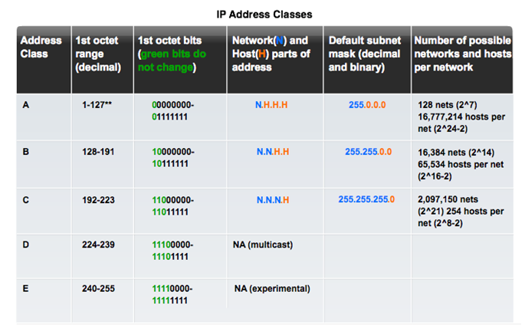
Legacy Classful Addressing
Notes:
7.1.4.4 Legacy Classful Addressing

Slide 20
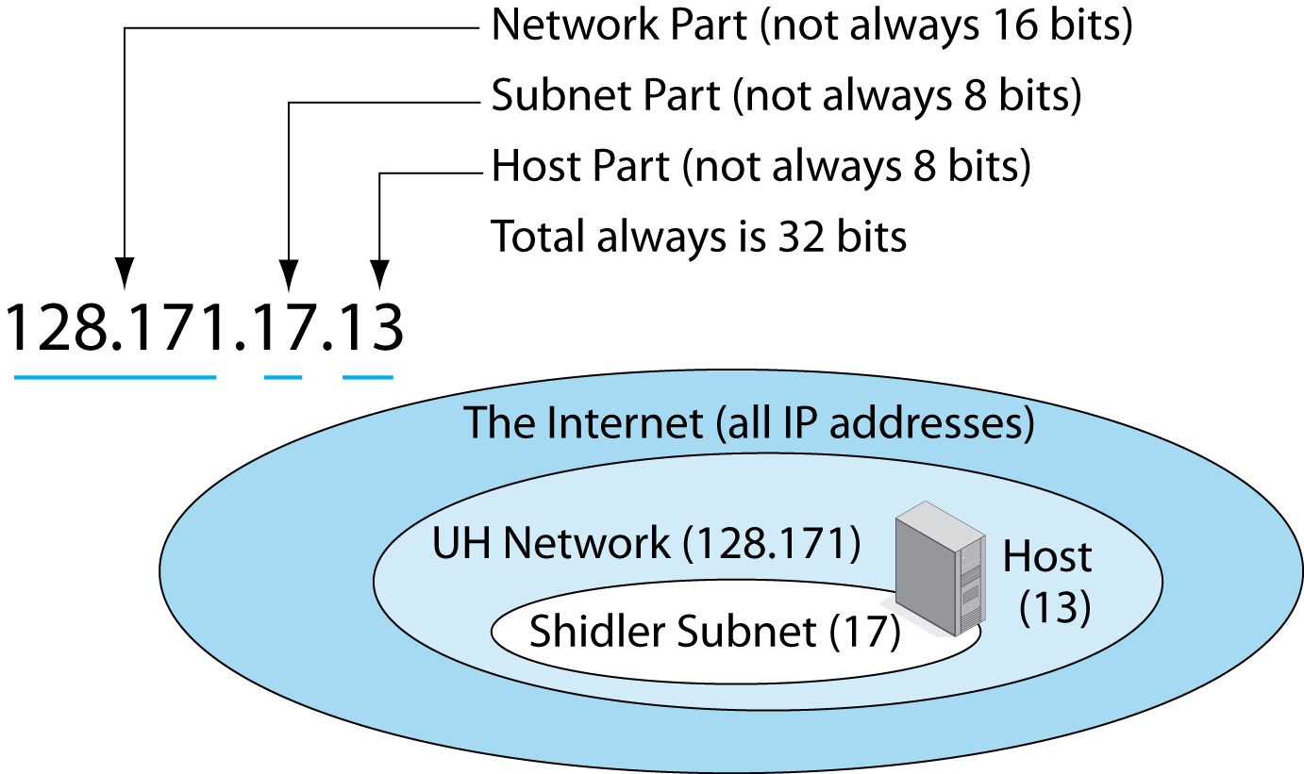
Legacy Classful Addressing
An IPv4 address usually has three parts.

Slide 21
Subnets
223.1.1.0/24
IP address:
subnet part - high order bits
host part - low order bits
what’s a subnet ?
subnet is a logical subdivision of an IP network.
Device interfaces with same subnet part/network part of IP address
can physically reach each other without intervening router
223.1.2.0/24
223.1.1.1
223.1.1.2
223.1.2.1
223.1.1.4
223.1.2.9
223.1.2.2
223.1.1.3
223.1.3.27
subnet
223.1.3.1
223.1.3.2
223.1.3.0/24
Network consisting of 3 subnets
subnet mask: /24
Network Layer
4-

Slide 22
Subnets
223.1.1.2
how many?
223.1.1.1
223.1.1.4
How many addresses are being wasted for each subnet?
223.1.1.3
223.1.9.2
223.1.7.2
223.1.9.1
223.1.7.1
223.1.8.1
223.1.8.2
223.1.2.6
223.1.3.27
223.1.2.1
223.1.2.2
223.1.3.1
223.1.3.2

Slide 23
Reasons for Subnetting
Subnetting is the process of segmenting a network into multiple smaller network spaces called subnetworks or subnets.
Large networks must be segmented into smaller subnetworks, creating smaller groups of devices and services to:
Control traffic by containing broadcast traffic within each subnetwork.
Reduce overall network traffic and improve network performance.
Notes:
8.1.1.1 Reasons for Subnetting
8.1.1.2 Communication Between Subnets

Slide 24
Reasons for Subnetting
Communication Between Subnets
A router is necessary for devices on different networks and subnets to communicate.
Each router interface must have an IPv4 host address that belongs to the network or subnet to that the router interface is connected.
Devices on a network and subnet use the router interface attached to their LAN as their default gateway.

Slide 25
IP addressing: Classless Interdomain Routing
With CIDRized, network addresses, the network part of an IP address can be any number of bits long, rather than being constrained to 8, 16, or 24 bits.
A CIDRized network address has the dotted-decimal form a.b.c.d/x, where x indicates the number of leading bits in the 32-bit quantity that constitutes the network portion of the address.
An organization with 2,000 hosts could be allocated a block of only 2,048 host addresses of the form a.b.c.d/21 since a class B (/16) network, which supports up 65,634 hosts is too large yet
A class C (/24) network could only accommodate up to 2^8 - 2 = 254 hosts (two of the 28 = 256 addresses are reserved for special use)--too small

Slide 26
IP addressing: CIDR
CIDR: Classless InterDomain Routing
subnet portion of address of arbitrary length
address format: a.b.c.d/x, where x is # bits in subnet portion of address
subnet
part
host
part
11001000 00010111 00010000 00000000
200.23.16.0/24

Slide 27
Prefixes
32 bits
Prefix /27
Host
27 bits
5 bits
A range of IP addresses is given as a prefix, e.g. 192.0.2.128/27
In this example:
How many addresses are available?
What are the lowest and highest addresses?

Slide 28
Golden Rules for 192.0.2.128/27
Lowest 192.0.2.128 = Network Address
Highest 192.0.2.159 = Broadcast Address
Usable: 192.0.2.129 to 192.0.2.158
Number of usable addresses: 32 - 2 = 30

Slide 29
Netmask
an alternative (old) way of writing the prefix length
A ‘1' for a prefix/subnet bit and '0' for a host bit
Hence N x 1's followed by (32-N) x 0's
/27 =
11111111111111111111111111100000
255 . 255 . 255 . 224

Slide 30
Exercises
Network 10.10.10.0/25
How many addresses in total?
How many usable addresses?
What are the lowest and highest usable addresses?
Network 10.10.20.0/22
How many addresses in total?
How many usable addresses?
What the the lowest and highest usable addresses?

Slide 31
NAT: Network Address Translation
rest of
Internet
local network
(e.g., home network)
10.0.0/24
10.0.0.1
10.0.0.4
10.0.0.2
138.76.29.7
10.0.0.3
all datagrams leaving local
network have same single source NAT IP address: 138.76.29.7,different source port numbers
datagrams with source or
destination in this network
have 10.0.0/24 address for
source, destination (as usual)

Slide 32
Where do home network computers get their addresses and where does the router get its single IP address?
The answer is – DHCP.
The router gets its address from the ISP’s DHCP server,
The router runs a DHCP server to provide addresses to computers within the NAT-DHCP-router-controlled home network’s address space.
How does the router know the internal host to which it should forward a given datagram?
The trick is to use a NAT translation table at the NAT router,
Also include port numbers as well as IP addresses in the table entries.

Slide 33
NAT: network address translation
motivation: local network uses just one IP address as far as outside world is concerned:
range of addresses not needed from ISP: just one IP address for all devices
can change addresses of devices in local network without notifying outside world
can change ISP without changing addresses of devices in local network
devices inside local net not explicitly addressable, visible by outside world (a security plus)

Slide 34
Issues with NAT
Port numbers are meant to be used for addressing processes, not for addressing hosts. This is violated by NAT and can indeed cause problems for servers running on the home network.
Routers are supposed to process packets only up to layer 3.
The NAT protocol violates the end-to-end argument; i.e, hosts should be talking directly with each other, without interfering nodes modifying IP addresses and port numbers.
NAT interferes with P2P apps, including P2P file-sharing apps and P2P VoIP apps since in a P2P app, any participating Peer A should be able to initiate a TCP connection to any other participating Peer B. A peer behind a NAT can’t act as a server to accept TCP connections.

Slide 35
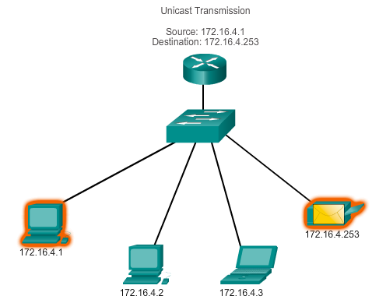
IPv4 Unicast, Broadcast, and Multicast Unicast Transmission
In an IPv4 network, the hosts can communicate one of three different ways:
Unicast, Broadcast, and Multicast
#1 Unicast – the process of sending a packet from one host to an individual host.
Notes:
7.1.3.3 Unicast Transmission

Slide 36
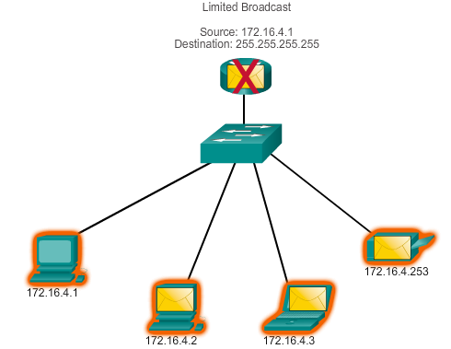
IPv4 Unicast, Broadcast, and Multicast Broadcast Transmission
In an IPv4 network, the hosts can communicate one of three different ways: Unicast, Broadcast, and Multicast.
#2 Broadcast – the process of sending a packet from one host to all hosts in the network.
Directed broadcast
Destination 172.16.4.255
Hosts within the 172.16.4.0/24 network
NOTE: Routers do not forward a limited broadcast!
Directed broadcast
Destination 172.16.4.255
Hosts within the 172.16.4.0/24 network
Notes:
7.1.3.4 Broadcast Transmission

Slide 37
IPv4 Unicast, Broadcast, and Multicast Multicast Transmission
#3 Multicast – The process of sending a packet from one host to a selected group of hosts, possibly in different networks.
Reduces traffic
Reserved for addressing multicast groups – 224.0.0.0 to 239.255.255.255.
Link local – 224.0.0.0 to 224.0.0.255 (Example: routing information exchanged by routing protocols)
Globally scoped addresses – 224.0.1.0 to 238.255.255.255 (Example: 224.0.1.1 has been reserved for Network Time Protocol)
Notes:
7.1.3.5 Multicast Transmission

Slide 38
Types of IPv4 Address Public and Private IPv4 Addresses
Private address blocks are:
Hosts that do not require access to the Internet can use private addresses
10.0.0.0 to 10.255.255.255 (10.0.0.0/8)
172.16.0.0 to 172.31.255.255 (172.16.0.0/12)
192.168.0.0 to 192.168.255.255 (192.168.0.0/16)
Shared address space addresses:
Not globally routable
Intended only for use in service provider networks
Address block is 100.64.0.0/10
Notes:
7.1.4.1 Public and Private IV4 Addresses

Slide 39
Types of IPv4 Address Special Use IPv4 Addresses
Network and Broadcast addresses – Within each network, the first and last addresses cannot be assigned to hosts.
Loopback addresses – 127.0.0.1 is a special address that hosts use to direct traffic to themselves (addresses 127.0.0.0 to 127.255.255.255 are reserved).
Link-local addresses – 169.254.0.0 to 169.254.255.255 (169.254.0.0/16) addresses can be automatically assigned to the local host.
TEST-NET addresses – 192.0.2.0 to 192.0.2.255 (192.0.2.0/24) are set aside for teaching and learning purposes; used in documentation and network examples.
Experimental addresses – 240.0.0.0 to 255.255.255.254 are listed as reserved.
Notes:
7.1.4.3 Special Use IPv4 Addresses

Slide 40
Network Layer in Communication IPv4 Limitations
IP address depletion
More and more IP-enabled devices are connecting
Internet routing table expansion
The Internet routing tables continue to grow which means Internet core routers require more processing power, memory, and overhead.
Lack of true end-to-end model
IPv4 networks typically use NAT as the solution to address depletion.
However, NAT hides the true source address of traffic, which can cause other issues.
Lack of end-to-end connectivity
Notes:
6.1.4.1 Limitations of IPv4

Slide 41
Chapter 4: outline
4.1 introduction
4.2 virtual circuit and datagram networks
4.3 what’s inside a router
4.4 IP: Internet Protocol
datagram format
IPv4 addressing
ICMP
IPv6
4.5 routing algorithms
link state
distance vector
hierarchical routing
4.6 routing in the Internet
RIP
OSPF
BGP
4.7 broadcast and multicast routing

Slide 42
ICMP: Internet Control Message Protocol
used by hosts & routers to communicate network-level information
error reporting: unreachable host, network, port, protocol
echo request/reply (used by ping)
network-layer “above” IP:
ICMP msgs carried in IP datagrams
ICMP message: type, code plus first 8 bytes of IP datagram causing error
Type Code description
0 0 echo reply (ping)
3 0 dest. network unreachable
3 1 dest host unreachable
3 2 dest protocol unreachable
3 3 dest port unreachable
3 6 dest network unknown
3 7 dest host unknown
4 0 source quench (congestion
control - not used)
8 0 echo request (ping)
9 0 route advertisement
10 0 router discovery
11 0 TTL expired
12 0 bad IP header

Slide 43
The most typical use of ICMP is for error reporting.
ICMP is often considered part of IP, but architecturally lies just above IP, as ICMP messages are carried inside IP packets.
That is, ICMP messages are carried as IP payload, just as TCP or UDP segments are carried as IP payload.
ICMP messages have a type and a code field
The well-known ping program sends an ICMP type 8 code 0 message to the specified host.
The destination host, seeing the echo request, sends back a type 0 code 0 ICMP echo reply.
Also Traceroute also uses ICMP messages.
During Telnet, FTP, HTTP sessions, error messages like “Destination network unreachable.” originate in ICMP.

Slide 44
Traceroute and ICMP
source sends series of UDP segments to dest
first set has TTL =1
second set has TTL=2, etc.
unlikely port number
when nth set of datagrams arrives to nth router:
router discards datagrams
and sends source ICMP messages (type 11, code 0)
ICMP messages include name of router & IP address
when ICMP message arrives, source records RTTs
stopping criteria:
UDP segment eventually arrives at destination host
destination returns ICMP “port unreachable” message (type 3, code 3)
source stops
Standard Traceroute program sends sets of 3 packets with same TTL; thus the Traceroute output provides three results for each TTL.
3 probes
3 probes
3 probes

Slide 45
IPv6: motivation
initial motivation: 32-bit address space soon to be completely allocated.
additional motivation:
header format helps speed processing/forwarding
header changes to facilitate QoS
IPv6 datagram format:
fixed-length 40 byte header
no fragmentation allowed
Notes:
https://ipv4.potaroo.net/

Slide 46
Introducing IPv6
Larger address space
IPv6 addresses are 128 bits, compared to IPv4’s 32 bits.
There are enough IPv6 addresses to allocate more than the entire IPv4 Internet address space to everyone on the planet.
Elimination of public-to-private NAT
End-to-end communication traceability is possible.
Elimination of broadcast addresses
IPv6 now includes unicast, multicast, and anycast addresses.
Support for mobility and security
Helps ensure compliance with mobile IP and IPsec standards.
Simplified header for improved router efficiency
Notes:
Larger address space
IPv6 addresses are 128 bits, compared to IPv4’s 32 bits.
This larger address space provides several benefits, including improved global reachability and flexibility, the ability to aggregate prefixes that are announced in routing tables, and easier multihoming to several Internet service providers (ISPs).
Elimination of public-to-private NAT
The larger address space allows end-to-end communication without NAT.
Elimination of broadcast addresses
IPv6 includes unicast addresses (one to one), multicast addresses (one to many), and a new type called anycast addresses (one to nearest).
IPv6 does not have broadcast addresses.
Simplified header for improved router efficiency
A simpler header provides several advantages over IPv4, including improved routing efficiency for performance and forwarding-rate scalability, no requirement for processing checksums, simpler and more efficient extension header mechanisms, and flow labels for per-flow processing with no need to examine the transport layer information to identify the various traffic flows.
Support for mobility and security
Mobility and security help ensure compliance with mobile IP and IPsec standards.

Slide 47
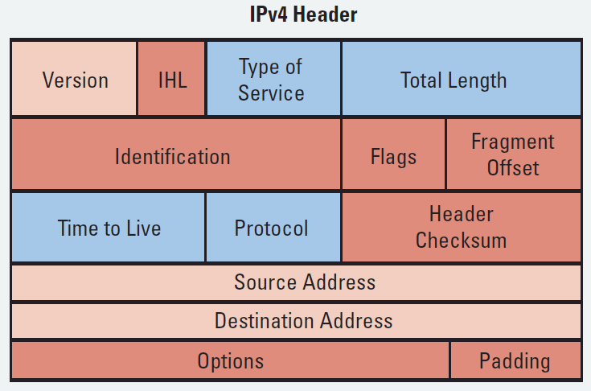
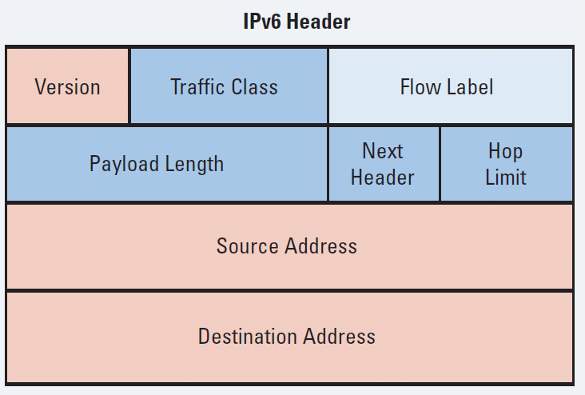
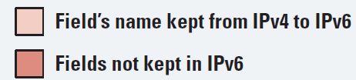
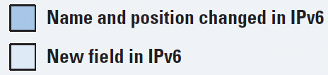
IPv4 Header vs. IPv6 Header
The IPv4 header has 20 octets containing 12 basic header fields.
The IPv6 header has 40 octets containing 8 fields.
Three of these fields are identical in nature.
Other fields serve similar functions as in IPv4.
The remaining IPv4 fields no longer exist in IPv6.
Notes:
The IPv6 header contains the following fields:
Version—A 4-bit field, the same as in IPv4. For IPv6, this field contains the number 6; for IPv4, this field contains the number 4.
Traffic class—An 8-bit field similar to the type of service (ToS) field in IPv4. This field tags the packet with a traffic class that it uses in differentiated services (DiffServ) quality of service (QoS). These functionalities are the same for IPv6 and IPv4.
Flow label—This 20-bit field is new in IPv6. It can be used by the source of the packet to tag the packet as being part of a specific flow, allowing multilayer switches and routers to handle traffic on a per-flow basis rather than per-packet, for faster packet-switching performance. This field can also be used to provide QoS.
Payload length—This 16-bit field is similar to the IPv4 total length field.
Next header—The value of this 8-bit field determines the type of information that follows the basic IPv6 header. It can be a transport-layer packet, such as Transmission Control Protocol (TCP) or User Datagram Protocol (UDP), or it can be an extension header. The next header field is similar to the protocol field of IPv4.
Hop limit—This 8-bit field specifies the maximum number of hops that an IP packet can traverse. Similar to the time to live (TTL) field in IPv4, each router decreases this field by one. Because there is no checksum in the IPv6 header, an IPv6 router can decrease the field without recomputing the checksum; in IPv4 routers the recomputation costs processing time. If this field ever reaches 0, a message is sent back to the source of the packet and the packet is discarded.
Source address—This field has 16 octets or 128 bits. It identifies the source of the packet.
Destination address—This field has 16 octets or 128 bits. It identifies the destination of the packet.
Extension headers—The extension headers, if any, and the data portion of the packet follow the other eight fields. The number of extension headers is not fixed, so the total length of the extension header chain is variable.
Notice that the IPv6 header does not have a header checksum field. Because link-layer technologies perform checksum and error control and are considered relatively reliable, an IP header checksum is considered to be redundant. Without the IP header checksum, upper-layer checksums, such as within UDP, are mandatory with IPv6.

Slide 48
IPv6 Address Specifics
The 128-bit IPv6 address is written using hexadecimal numbers.
Specifically, it consists of 8, 16-bit segments separated with colons between each set of four hex digits (16 bits).
The format is x:x:x:x:x:x:x:x, where x is a 16-bit hexadecimal field therefore each x is representing four hexadecimal digits.
An example address is as follows:
2035:0001:2BC5:0000:0000:087C:0000:000A
Homework: Read about Abbreviating IPv6 Addresses

Slide 49
Is IPv4 Obsolete?
IPv4 is in no danger of disappearing overnight.
It will coexist with IPv6 and then gradually be replaced.
IPv6 provides many transition options including:
Dual stack:
Both IPv4 and IPv6 are configured and run simultaneously on the interface.
IPv6-to-IPv4 (6to4) tunneling and IPv4-compatible tunneling.
NAT protocol translation (NAT-PT) between IPv6 and IPv4.

Slide 50
Transition from IPv4 to IPv6
tunneling: IPv6 datagram carried as payload in IPv4 datagram among IPv4 routers
IPv4 header fields
IPv6 header fields
IPv4 payload
IPv4 source, dest addr
IPv6 source dest addr
UDP/TCP payload
IPv6 datagram
IPv4 datagram

Slide 51
Tunneling
A
B
IPv4 tunnel
connecting IPv6 routers
E
F
logical view:
IPv6
IPv6
IPv6
IPv6
A
B
C
D
E
F
physical view:
IPv6
IPv6
IPv4
IPv4
IPv6
IPv6
flow: X
src: A
dest: F
data
src:B
dest: E
src:B
dest: E
flow: X
src: A
dest: F
data
Flow: X
Src: A
Dest: F
data
Flow: X
Src: A
Dest: F
data
A-to-B:
IPv6
B-to-C:
IPv6 inside
IPv4
B-to-C:
IPv6 inside
IPv4
E-to-F:
IPv6

Slide 52
Chapter 4: outline
4.1 introduction
4.2 virtual circuit and datagram networks
4.3 what’s inside a router
4.4 IP: Internet Protocol
datagram format
IPv4 addressing
ICMP
IPv6
4.5 routing algorithms
link state
distance vector
hierarchical routing
4.6 routing in the Internet
RIP
OSPF
BGP
4.7 broadcast and multicast routing

Slide 53
Forwarding and Routing
Forwarding is receiving packets on an interface and re-sending them out on another interface
Routing is deciding on the best path to reach any given destination
These are two different concepts!
Forwarding is done in hardware
Routing is a software function

Slide 54
Outline forwarding operation
Receive a datagram
Is it for us (Destination IP = ours)? Accept
Look up the destination IP address in forwarding table (FIB) to find the next hop
if not found, discard the datagram
Re-send to next hop

Slide 55
RIBs and FIBs
FIB (Forwarding Information Base) is the Forwarding Table
It contains destinations and the interfaces to get to those destinations
Used by the router to figure out where to send the packet
RIB (Routing Information Base) is the Routing Table
It contains a list of all the destinations and the various next hops used to get to those destinations – and lots of other information too!
One destination can have lots of possible next-hops only the best next-hop goes into the FIB

Slide 56
Forwarding
The best way to reach a given prefix is stored in the Forwarding Table
Each packet's destination address is looked up to decide where to send it next (the next hop)
Destination Prefix
Next Hop
10.10.0.0/16
1.2.3.3
10.10.1.0/24
1.2.3.4
10.10.2.0/24
1.2.3.5

Slide 57
Longest Prefix Rule
If the destination matches multiple prefixes, the longest prefix wins
Example: packet destination 10.10.1.1
Destination Prefix
Next Hop
10.10.0.0/16
1.2.3.3
MATCH!
10.10.1.0/24
1.2.3.4
Longest Prefix
MATCH!
10.10.2.0/24
1.2.3.5
no match

Slide 58
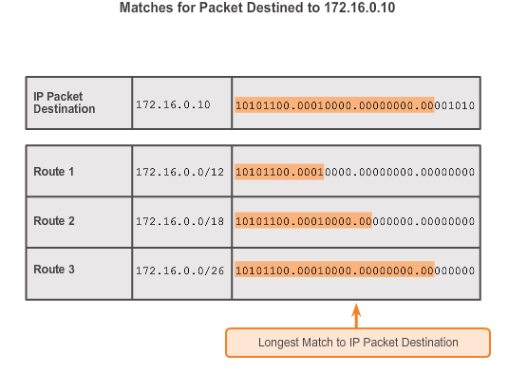
Longest Prefix Rule #another example
Notes:
3.5.3.2 Best Route = Longest Match

Slide 59
Default route
Sometimes referred to as gateway of last resort
Destination 0.0.0.0/0 or ::/0
Matches every IP address
But only when there is no better match (longer prefix) for that destination

Slide 60
Routing
Deciding the best path to any given destination
Two types:
Configured manually: static routing
Learned automatically: dynamic routing

Slide 61
Path Determination
Best path is selected based on a metric
A metric is the value used to measure the distance to a given network.
Best path is the path with the lowest metric.
Examples
Routing Information Protocol (RIP) - Hop count
Open Shortest Path First (OSPF) - Cost based on cumulative bandwidth from source to destination
Enhanced Interior Gateway Routing Protocol (EIGRP) - Bandwidth, delay, load, reliability
Notes:
1.2.2.2 Best Path

Slide 62
Load Balancing
When a router has two or more paths to a destination with equal cost metrics, then the router forwards the packets using both paths equally:
Equal cost load balancing can improve network performance.
Equal cost load balancing can be configured to use both dynamic routing protocols and static routes.
Homework: Which Routing protocols support Equal load balancing
Notes:
1.2.2.3 Load Balancing

Slide 63
Static Routes
Static routes are manually configured
They define an explicit path between two networking devices.
Static routes must be manually updated if the topology changes.
Their benefits include improved security and control of resources.
A default static route is used when the routing table does not contain a path for a destination network.
Notes:
1.3.3.1 Static Routes

Slide 64
Dynamic Routing
Dynamic routing is used by routers to share information about the reachability and status of remote networks.
It performs network discovery and maintains routing tables.
Notes:
1.3.4.1 Dynamic Routing

Slide 65
Dynamic Routing Protocols
Routing Protocols are used to facilitate the exchange of routing information between routers.
The purpose of dynamic routing protocols includes:
Discovery of remote networks
Maintaining up-to-date routing information
Choosing the best path to destination networks
Ability to find a new best path if the current path is no longer available
Notes:
3.1.1.2 Purpose of Dynamic Routing Protocols

Slide 66
The Role of Dynamic Routing Protocols
Advantages of dynamic routing include:
Automatically share information about remote networks
Determine the best path to each network and add this information to their routing tables
require less administrative overhead
Disadvantages of dynamic routing include:
Part of a router’s resources are dedicated for protocol operation, including CPU time and network link bandwidth
Times when static routing is more appropriate
Notes:
3.1.1.3 The Role of Dynamic Routing Protocols

Slide 67
Using Static Routing
Networks typically use a combination of both static and dynamic routing.
Static routing has several primary uses:
Providing ease of routing table maintenance in smaller networks that are not expected to grow significantly.
Routing to and from a stub network (pocket network).
Accessing a single default router. This is used to represent a path to any network that does not have a match in the routing table.
NB: Stub Network is a casual term describing a computer network with no knowledge of other networks, that will typically send much or all of its non-local traffic out via a single path, with the network aware only of a default route to non-local destinations.
Notes:
3.1.2.1 Using Static Routing
Stub network: No information about other networks

Slide 68
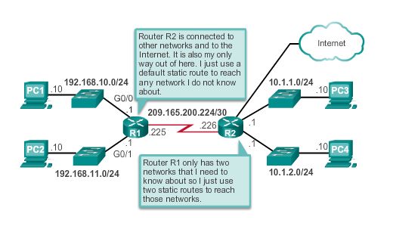
Using Static Routing (cont.)
Notes:
3.1.2.1 Using Static Routing (cont.)

Slide 69
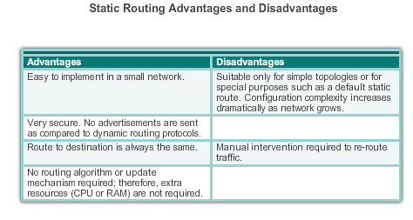
Dynamic verses Static Routing Static Routing Scorecard
Notes:
3.1.2.2 Static Routing Scorecard

Slide 70
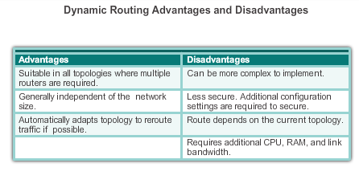
Dynamic verses Static Routing Dynamic Routing Scorecard
Notes:
3.1.2.4 Dynamic Routing Scorecard

Slide 71
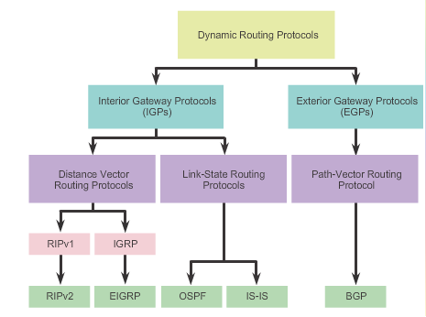
Types of Routing Protocols Classifying Routing Protocols
Notes:
3.1.4.1 Classifying Routing Protocols

Slide 72
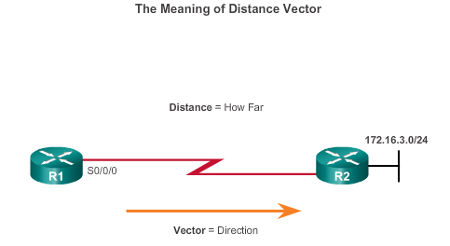
Types of Routing Protocols Distance Vector Routing Protocols
Distance vector IPv4 IGPs:
RIPv1 - First generation legacy protocol
RIPv2 - Simple distance vector routing protocol
For R1, 172.16.3.0/24 is one hop away (distance). It can be reached through R2 (vector).
Notes:
3.1.4.3 Distance Vector Routing Protocols

Slide 73
Types of Routing Protocols Distance Vector or Link-State Routing Protocols
Distance vector protocols use routers as sign posts along the path to the final destination.
A link-state routing protocol is like having a complete map of the network topology.
The sign posts along the way from source to destination are not necessary, because all link-state routers are using an identical map of the network.
A link-state router uses the link-state information to create a topology map and to select the best path to all destination networks in the topology.
Notes:
3.1.4.3 Distance Vector Routing Protocols (cont.)

Slide 74
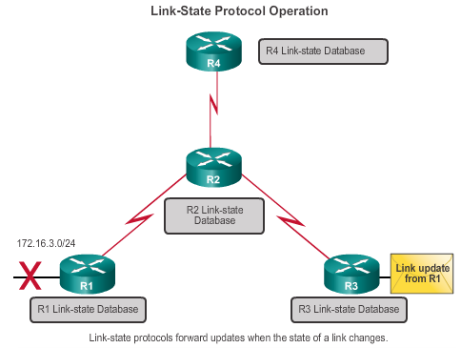
Types of Routing Protocols Link-State Routing Protocols
Link-state IPv4 IGPs:
OSPF - Popular standards based routing protocol
IS-IS - Popular in provider networks.
Notes:
3.1.4.4 Link-State Routing Protocols

Slide 75
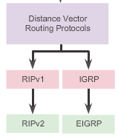
Distance Vector Routing Protocol Operation Distance Vector Technologies
Distance vector routing protocols:
Share updates between neighbors
Not aware of the network topology
Some send periodic updates to broadcast IP 255.255.255.255 even if topology has not changed
Updates consume bandwidth and network device CPU resources
Notes:
3.2.1.1 Distance Vector Technologies

Slide 76
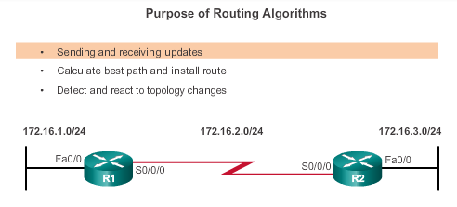
Distance Vector Routing Protocol Operation Distance Vector Algorithm
RIP uses the Bellman-Ford algorithm as its routing algorithm.
Notes:
3.2.1.2 Distance Vector Algorithm

Slide 77
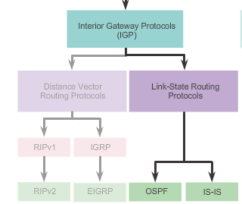
Link-State Routing Protocol Operation Shortest Path First Protocols
Notes:
3.4.1.1 Shortest Path First Protocols

Slide 78
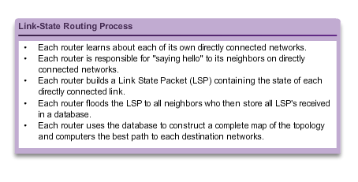
Link-State Updates Link-State Routing Process
Notes:
3.4.2.1 Link-State Routing Process

Slide 79
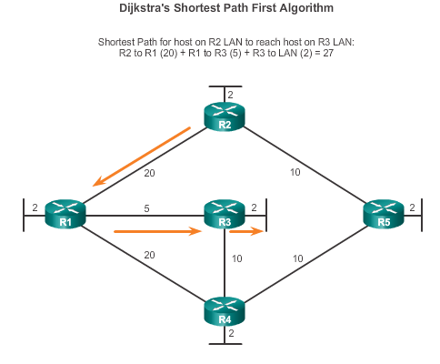
Link-State Routing Protocol Operation Dijkstra’s Algorithm
Notes:
3.4.1.2 Dijkstra's Algorithm
Let distance from start vertex from start vertex = 0
Update the rest from the start = infinity
Repeat
Visit unvisited vertex with the smallest known distance from start
For the current vertex, examine the unvisited neighbors
For the current vertex, calculate the distance of each neighbor from start vertex
If the calculated distance of a vertex is less than the known, update the shortest distance
Update the previous vertex for each of the updated distances
Add the current vertex to the list of visited vertices
Until all the vertices have been visited

Slide 80
Why Use Link-State Routing Protocols Protocols that Use Link-State
There are only two link-state routing protocols:
Open Shortest Path First (OSPF) most popular
began in 1987
two current versions
OSPFv2 - OSPF for IPv4 networks
OSPFv3 - OSPF for IPv6 networks
IS-IS was designed by International Organization for Standardization (ISO )
Notes:
3.4.3.3 Protocols that Use Link-State

Slide 81
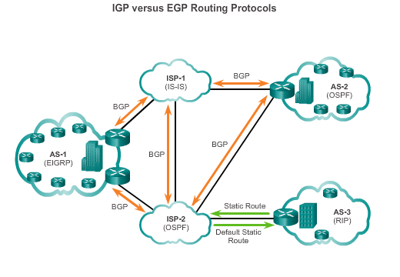
Types of Routing Protocols IGP and EGP Routing Protocols
Interior Gateway Protocols (IGP) -
Used for routing within an AS
Include RIP, EIGRP, OSPF, and IS-IS
Exterior Gateway Protocols (EGP) -
Used for routing between AS
Official routing protocol used by the Internet
Notes:
3.1.4.2 IGP and EGP Routing Protocols

Slide 82
Interior gateway protocols
most common routing protocols:
RIP: Routing Information Protocol
OSPF: Open Shortest Path First

Slide 83
RIP (Routing Information Protocol)
included in BSD-UNIX distribution in 1982
distance vector algorithm
distance metric: # hops (max = 15 hops), each link has cost 1
DVs exchanged with neighbors every 30 sec in response message (aka advertisement)
each advertisement: list of up to 25 destination subnets (in IP addressing sense)
from router A to destination subnets:
u
v
subnet hops
u 1
v 2
w 2
x 3
y 3
z 2
A
B
w
x
z
C
D
y

Slide 84
RIP: example
z
w
x
y
A
D
B
C
routing table in router D
destination subnet next router # hops to dest
w A 2
y B 2
z B 7
x -- 1
…. …. ....

Slide 85
RIP: example
A-to-D advertisement
dest next hops
w - 1
x - 1
z C 4
…. … ...
z
w
x
y
A
D
B
C
routing table in router D
destination subnet next router # hops to dest
w A 2
y B 2
z B 7
x -- 1
…. …. ....
A
5

Slide 86
RIP: link failure, recovery
if no advertisement heard after 180 sec --> neighbor/link declared dead
routes via neighbor invalidated
new advertisements sent to neighbors
neighbors in turn send out new advertisements (if tables changed)
link failure info quickly (?) propagates to entire net
poison reverse used to prevent ping-pong loops (infinite distance = 16 hops)
In a computer network that uses RIP or other distance vector routing protocols, a poison reverse is a way in which a gateway node tells its neighbor gateways that one of the gateways is no longer connected.

Slide 87
RIP table processing
RIP routing tables managed by application-level process called route-d (daemon)
advertisements sent in UDP packets, periodically repeated
routed
routed
transport
(UDP)
transprt
(UDP)
network forwarding
(IP) table
network
(IP)
forwarding
table
link
link
physical
physical

Slide 88
OSPF (Open Shortest Path First)
“open”: publicly available
uses link state algorithm
LS packet dissemination
topology map at each node
route computation using Dijkstra’s algorithm
OSPF advertisement carries one entry per neighbor
advertisements flooded to entire AS
carried in OSPF messages directly over IP (rather than TCP or UDP
IS-IS routing protocol: nearly identical to OSPF

Slide 89
OSPF “advanced” features (not in RIP)
security: all OSPF messages authenticated (to prevent malicious intrusion)
multiple same-cost paths allowed (only one path in RIP)
for each link, multiple cost metrics for different TOS (e.g., satellite link cost set “low” for best effort ToS; high for real time ToS)
integrated uni- and multicast support:
Multicast OSPF (MOSPF) uses same topology data base as OSPF
hierarchical OSPF in large domains.

Slide 90
Hierarchical OSPF
boundary router
backbone router
backbone
area
border
routers
area 3
internal
routers
area 1
area 2

Slide 91
Hierarchical OSPF
two-level hierarchy: local area, backbone.
link-state advertisements only in area
each nodes has detailed area topology; only know direction (shortest path) to nets in other areas.
area border routers: “summarize” distances to nets in own area, advertise to other Area Border routers.
backbone routers: run OSPF routing limited to backbone.
boundary routers: connect to other AS’s.

Slide 92
Internet inter-AS routing: BGP
BGP (Border Gateway Protocol): the de facto inter-domain routing protocol
“glue that holds the Internet together”
BGP provides each AS a means to:
eBGP: obtain subnet reachability information from neighboring ASs.
iBGP: propagate reachability information to all AS-internal routers.
determine “good” routes to other networks based on reachability information and policy.
allows subnet to advertise its existence to rest of Internet: “I am here”

